Slide 1

Vel Tech Rangarajan Dr. Sagunthala R&D Institute of Science and Technology
School of Computing
Department of Computer Science and Engineering
10211CS224 / FULL STACK APPLICATION DEVELOPMENT (JAVA)
END SEMESTER PROJECT REVIEW
Date: 06-05-2026
REACT JS BASED WEB APPLICATION FOR TICKET BOOKING
SDG: SDG 9 – (Industry ,Innovation ,&Infrastructure) & 12(Responsible Consumption and Production)
Presented By:
VINAY VIKRANT SINDAMKAR – VTU25539 – 23UECS0608
Courses Handling Faculty:
Dr. S.HEMAMALINI– M.E.,Ph.D.,

Slide 2
INTRODUCTION
Background of the problem:
Manual ticket booking systems lack automation and real-time seat management.
Why this project is important:
It simplifies ticket booking and provides instant confirmation with reduced errors.
Real-world relevance:
Useful for managing departmental events like technical fests, seminars, and workshops.
Brief overview of the system:
Useful for managing departmental events like technical fests, seminars, and workshops
1
2
3
4
5
6
7
8
9

Slide 3
PROBLEM STATEMENT
1
Ticket booking for internal events in institutions is often manual or basic.
Manual systems cause difficulties in managing participants and tracking availability.
Errors such as overbooking,data mismatches,and delayed confirmations occur.
No centralized system exists for monitoring bookkings and generating reports.
Lack of automation reduces efficiency and increases workload.
A Secure,reliable,automated system is needed for smooth ticket booking.
Real-time updates improve accuracy and user experience.
Administrators benefit from better event management and reporting tools.
2
3
4
5
6
7
8
9

Slide 4
OBJECTIVE(S)
To Design and develop a React JS-based web application for efficient event ticket booking.
To provide real-time ticket availability and instant booking confirmation.
To develop an admin panel for managing events, bookings, and users.
To develop an admin panel for managing events, bookings, and users.
1
2
3
4
5
6
7
8
9

Slide 5
PROPOSED SYSTEM
1.The proposed system is a React JS-based web application for managing event ticket booking in a single platform.
2. It allows users to register, view events, and book tickets.
3. Admin can create and manage events.
4. It provides real-time ticket availability and instant booking confirmation.
5. The system stores booking details securely and generates reports.
6. It reduces manual work and saves time.
7. It avoids mistakes in Money calculation.
8. It is faster and more efficient than manual systems.
1
2
3
4
5
6
7
8
9

Slide 6
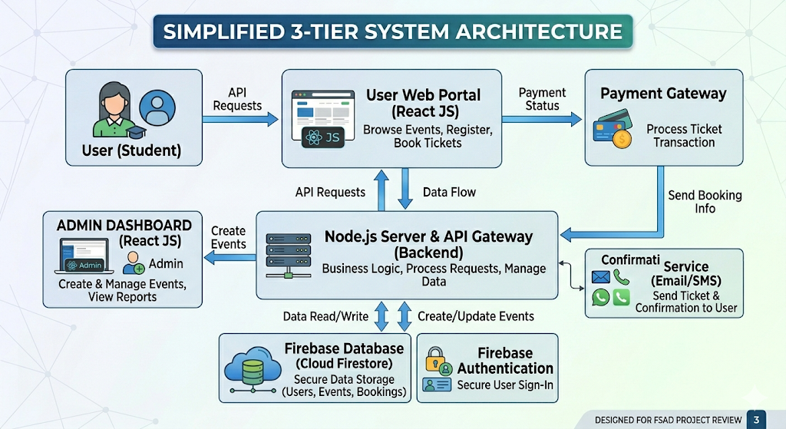
PROPOSED SYSTEM ARCHITECTURE
User (Student): Accesses the system to browse events and book tickets.
User Web Portal (React JS): Provides the interface for registration, booking, and navigation.
Payment Gateway: Handles secure online transactions and updates booking status.
Confirmation Service (Email/SMS): Sends ticket details and booking confirmations instantly.
Node.js Server & API Gateway: Processes requests, applies business logic, and connects components.
Admin Dashboard (React JS): Allows event creation, booking management, and report generation.
Firebase Database (Cloud Firestore): Stores user, event, and booking data securely.
Firebase Authentication: Ensures secure login and identity management for users and admins.
1
2
3
4
5
6
7
8
9

Slide 7
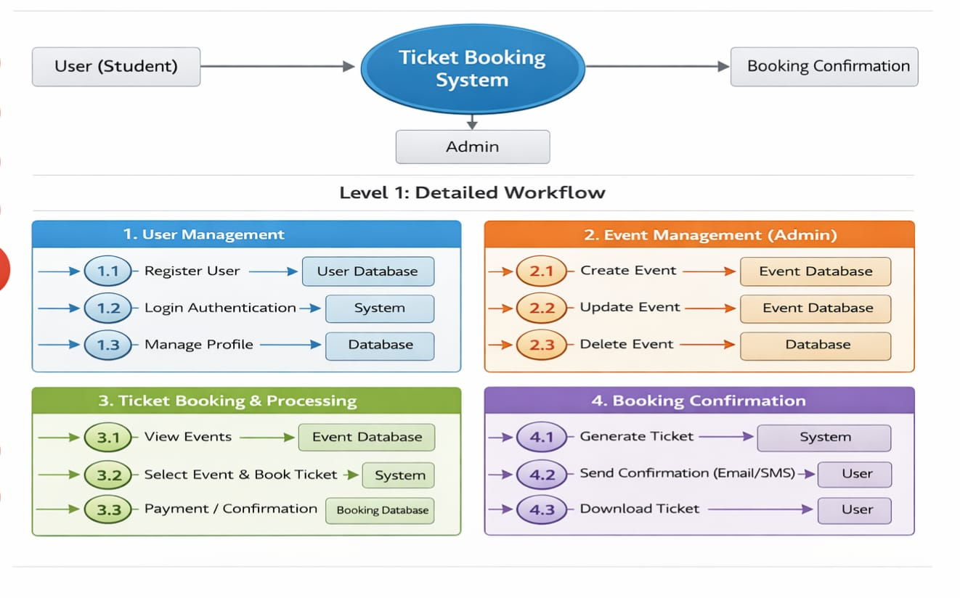
WORKFLOW
1
2
3
4
5
6
7
User Management: Students register, log in, and manage their profiles securely.
Event Management (Admin): Admins create, update, or delete events in the database.
Ticket Booking & Processing: Users view events, select tickets, make payments, and bookings are stored.
Booking Confirmation: System generates tickets, sends email/SMS confirmations, and allows downloads.
8
9

Slide 8
TECHNOLOGIES USED
Frontend:
1.HTML5
2.CSS3
3.JavaScript
4.React JS
Backend:
1.Node JS
Database:
1.Firebase
Third-Party API:
1.React JS
2.React Router
3.MongoDB/MySQL
Tools:
1.VS Code
2.Antigravity
Hardware/Software Requirements:
1. Minimum Intel i3, 4 GB RAM, 10 GB storage, stable internet; recommended Intel i5, 8 GB RAM, SSD, full HD display.
2. Windows/Mac/Linux OS, VS Code, Node.js v18+, npm/yarn, MongoDB/MySQL server, Chrome/Edge browser, Git, optional Postman/Docker.
1
2
3
4
5
6
7
8
9

Slide 9
MODULE DESCRIPTION
1
Module 1: User Management Handles user registration, login, and profile management with secure authentication.
Module 2: Ticket Booking & Processing Implements the main business logic for selecting events, booking tickets, and processing payments.
Module 3: Database Management Manages storage of user details, event data, and booking records while ensuring data integrity.
Module 4: Integration & Enhancements Includes third‑party APIs for payment gateways, OTP verification, and optional features like chatbots or maps.
Module 5: Reporting & Analytics Generates booking reports, usage statistics, and visual insights for administrators.
2
3
4
5
6
7
8
9

Slide 10
IMPLEMENTATION SCREENSHOTS
1
Home Page: Displays upcoming events and ticket options with a clean navigation bar.
Login Page: Allows users to securely sign in with email and password authentication.
Main Module (Ticket Booking): Handles event selection, seat booking, and payment processing.
Output Page: Shows booking confirmation, ticket details, and downloadable receipt.
2
3
4
5
6
7
8
9

Slide 11
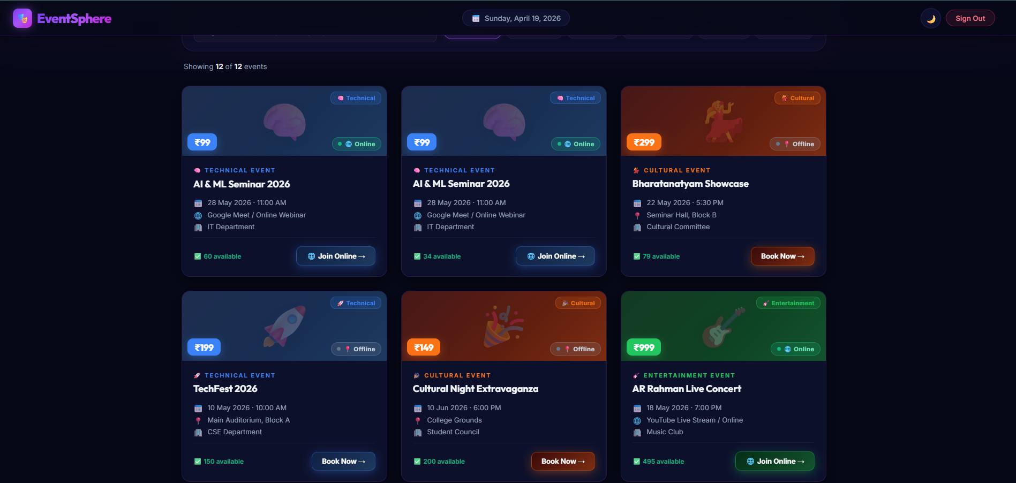
IMPLEMENTATION SCREENSHOTS
Displays upcoming technical, cultural, and entertainment events in a clean grid layout.
Shows event details like date, time, venue, price, and availability.
Allows users to book tickets or join online directly from the dashboard.
Provides real‑time updates and easy access to event categories.
Enhances user experience with a modern, organized interface for event management.
1
2
3
4
5
6
7
8(A)
9

Slide 12
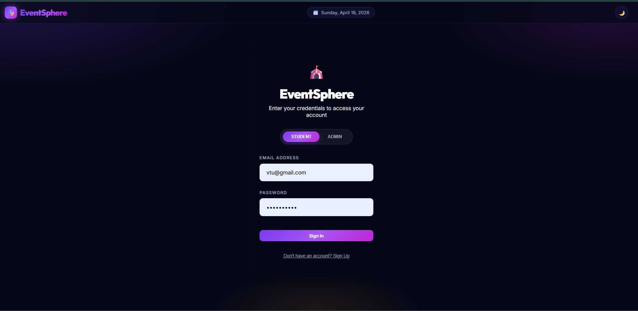
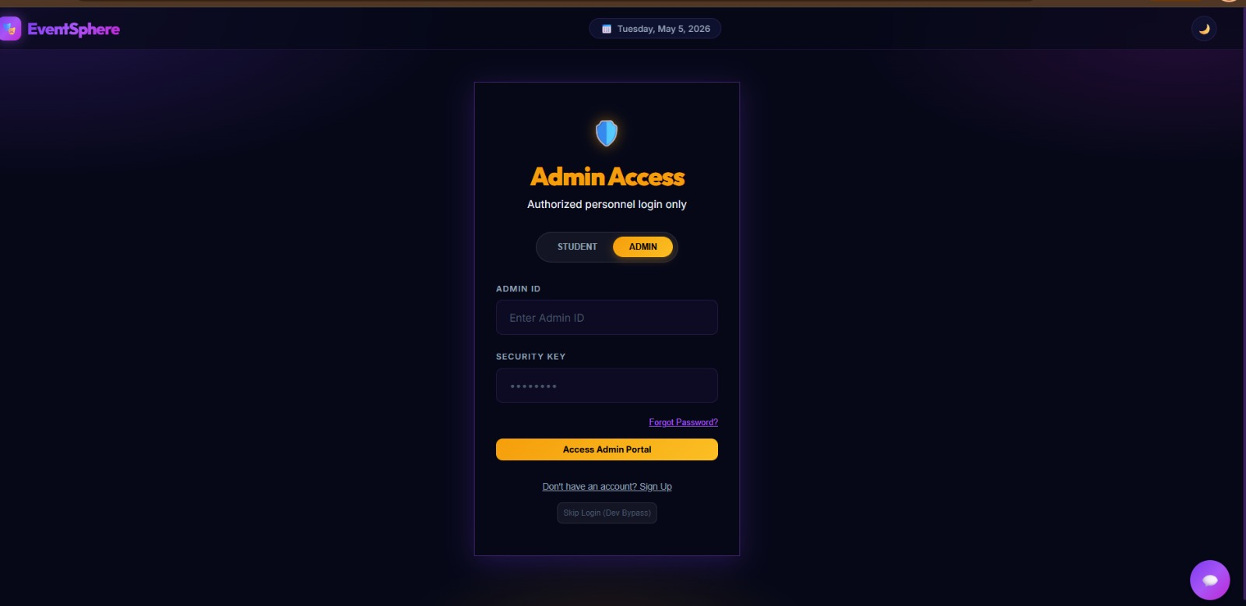
IMPLEMENTATION SCREENSHOTS
User Login Page
Admin Login Page
1
2
Provides secure access for authorized admins only with Admin ID and Security Key.
Includes features like Forgot Password and a clear Access Admin Portal button.
Ensures restricted role‑based entry for managing events and bookings.
3
4
5
6
7
8(B)
Provides secure login with role selection for students and admins.
Includes email and password authentication with a modern interface.
Ensures role‑based access control for event and ticket management.
9

Slide 13
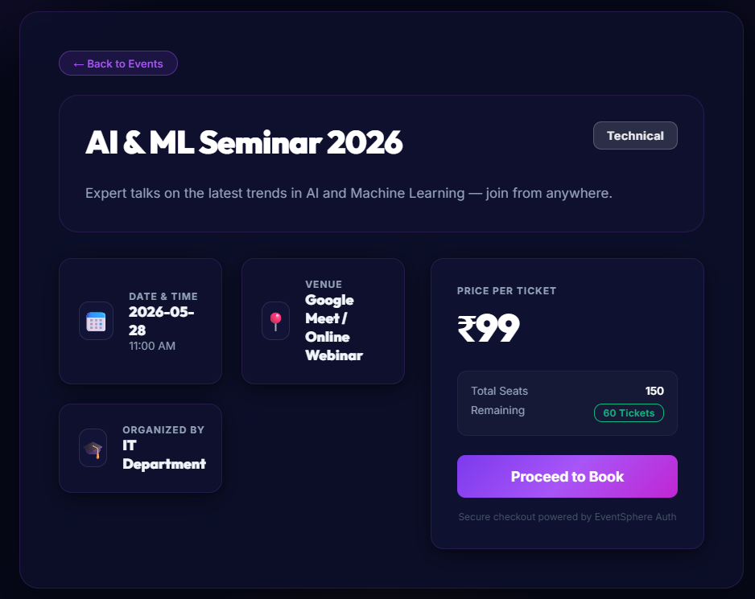
IMPLEMENTATION SCREENSHOTS
Promotes a technical seminar focused on AI and Machine Learning trends.
Provides clear details like date, time, venue, and organizer.
Shows ticket information including price, total seats, and remaining availability.
Includes a Proceed to Book button for easy registration.
Ensures secure booking with EventSphere authentication.
1
2
3
4
5
6
7
8(C)
9

Slide 14
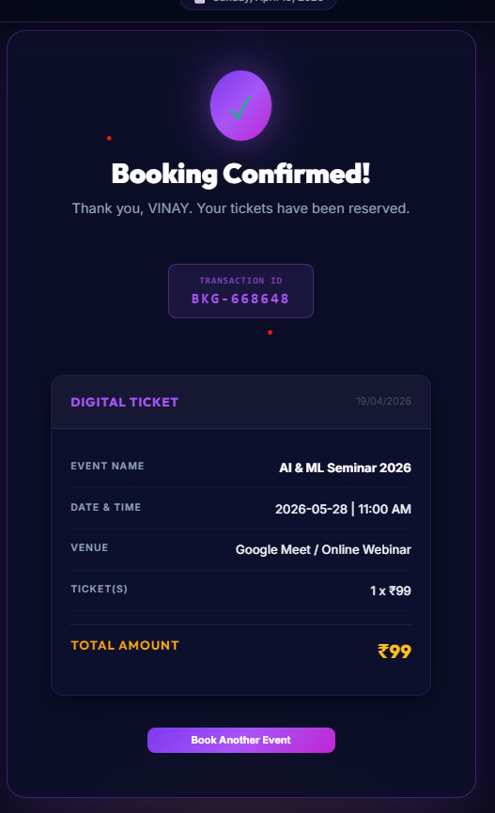
IMPLEMENTATION SCREENSHOTS
1
Confirms successful booking with event details, user name, and transaction ID.
Displays ticket information including price, quantity, and total amount.
Provides options like Book Another Event for quick navigation.
2
3
4
5
6
7
8(C)
9

Slide 15
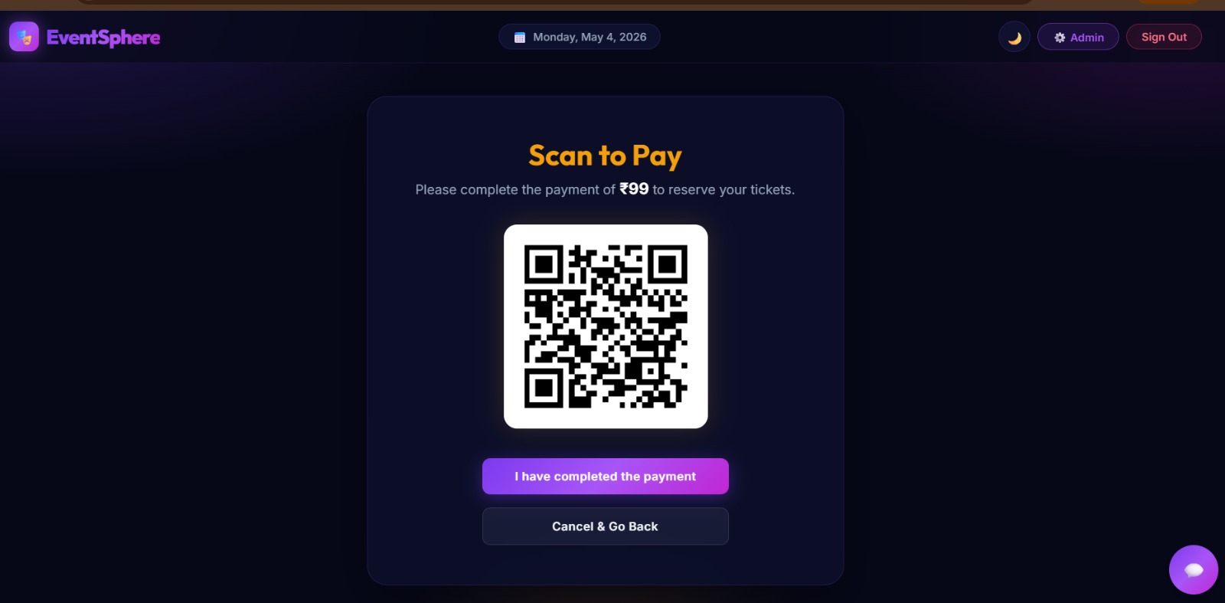
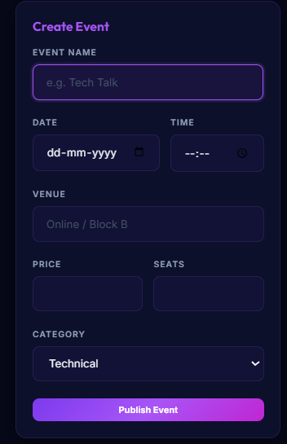
IMPLEMENTATION SCREENSHOTS
Provides a structured form to enter event details like name, date, time, venue, price, seats, and category.
Includes a clear Publish Event button to finalize and post the event.
Enables admins to digitally manage and publish events quickly and efficiently.
1
2
3
4
5
6
7
Provides a QR code option for quick and secure ticket payment.
Displays the amount to be paid and confirms reservation after completion.
Includes clear buttons for payment confirmation or cancellation.
8(C)
9

Slide 16
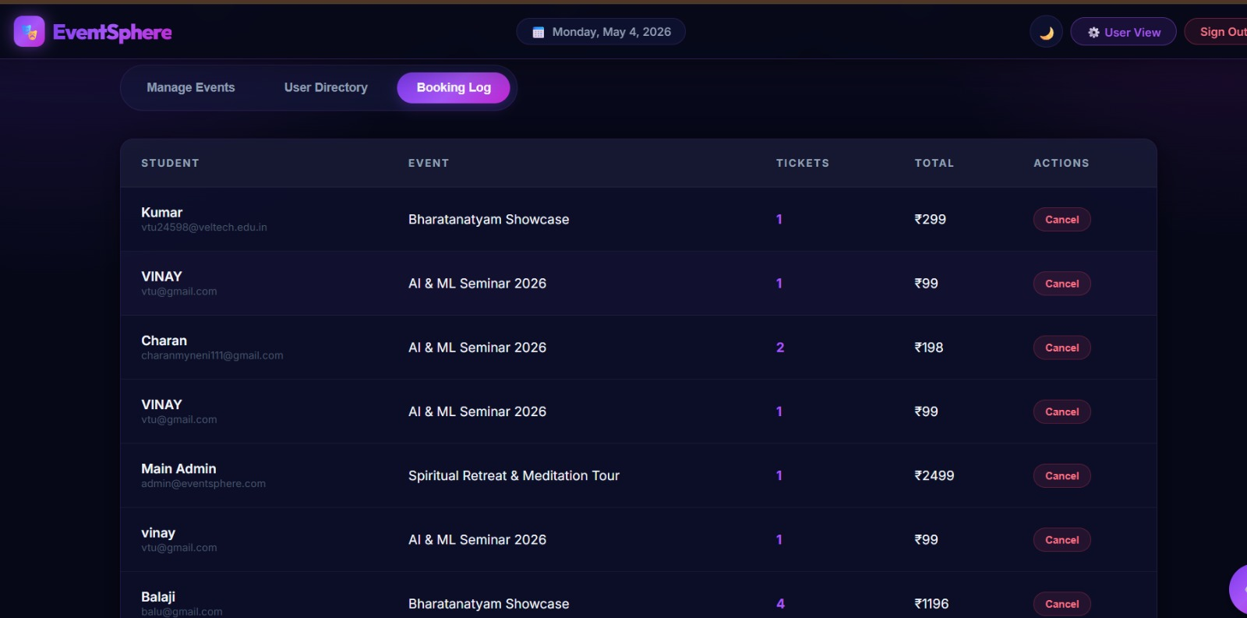
IMPLEMENTATION SCREENSHOTS
1
2
3
4
5
6
7
Displays a table of students, events, tickets, and total cost for easy tracking.
Provides admins with options to manage bookings or cancel entries.
Acts as a centralized log for monitoring event registrations efficiently.
8(C)
9

Slide 17
ADVANTAGES & LIMITATIONS
Advantages:
1.Time saving and Fully Automated.
2. Real-time ticket availability and instant confirmation.
3. Easy access and user-friendly interface.
Limitations:
1. Initial setup and development complexity.
2.Internet Dependency(Stable Internet connection is Required).
3.Security and Malpractice Issues.
4. Depends on system/server availability.
1
2
3
4
5
6
7
8
9

Slide 18
Thank you

